Slide 1
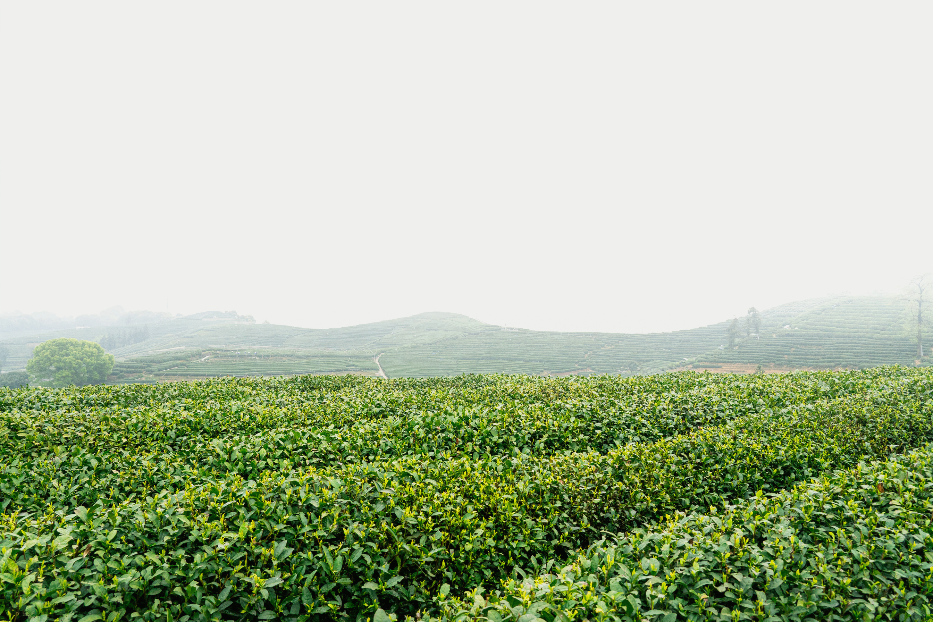


P08
AgriQual

Slide 2
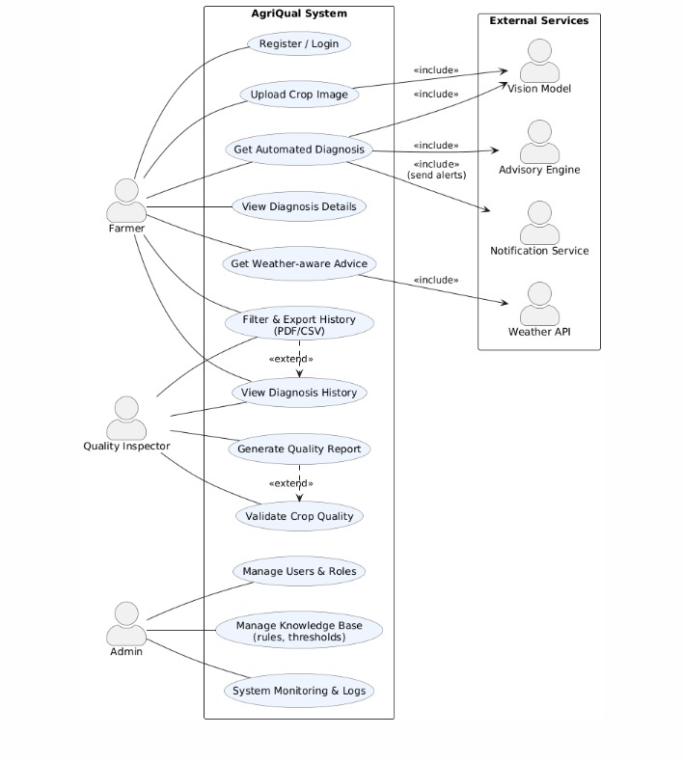
The system use case diagram

Slide 3
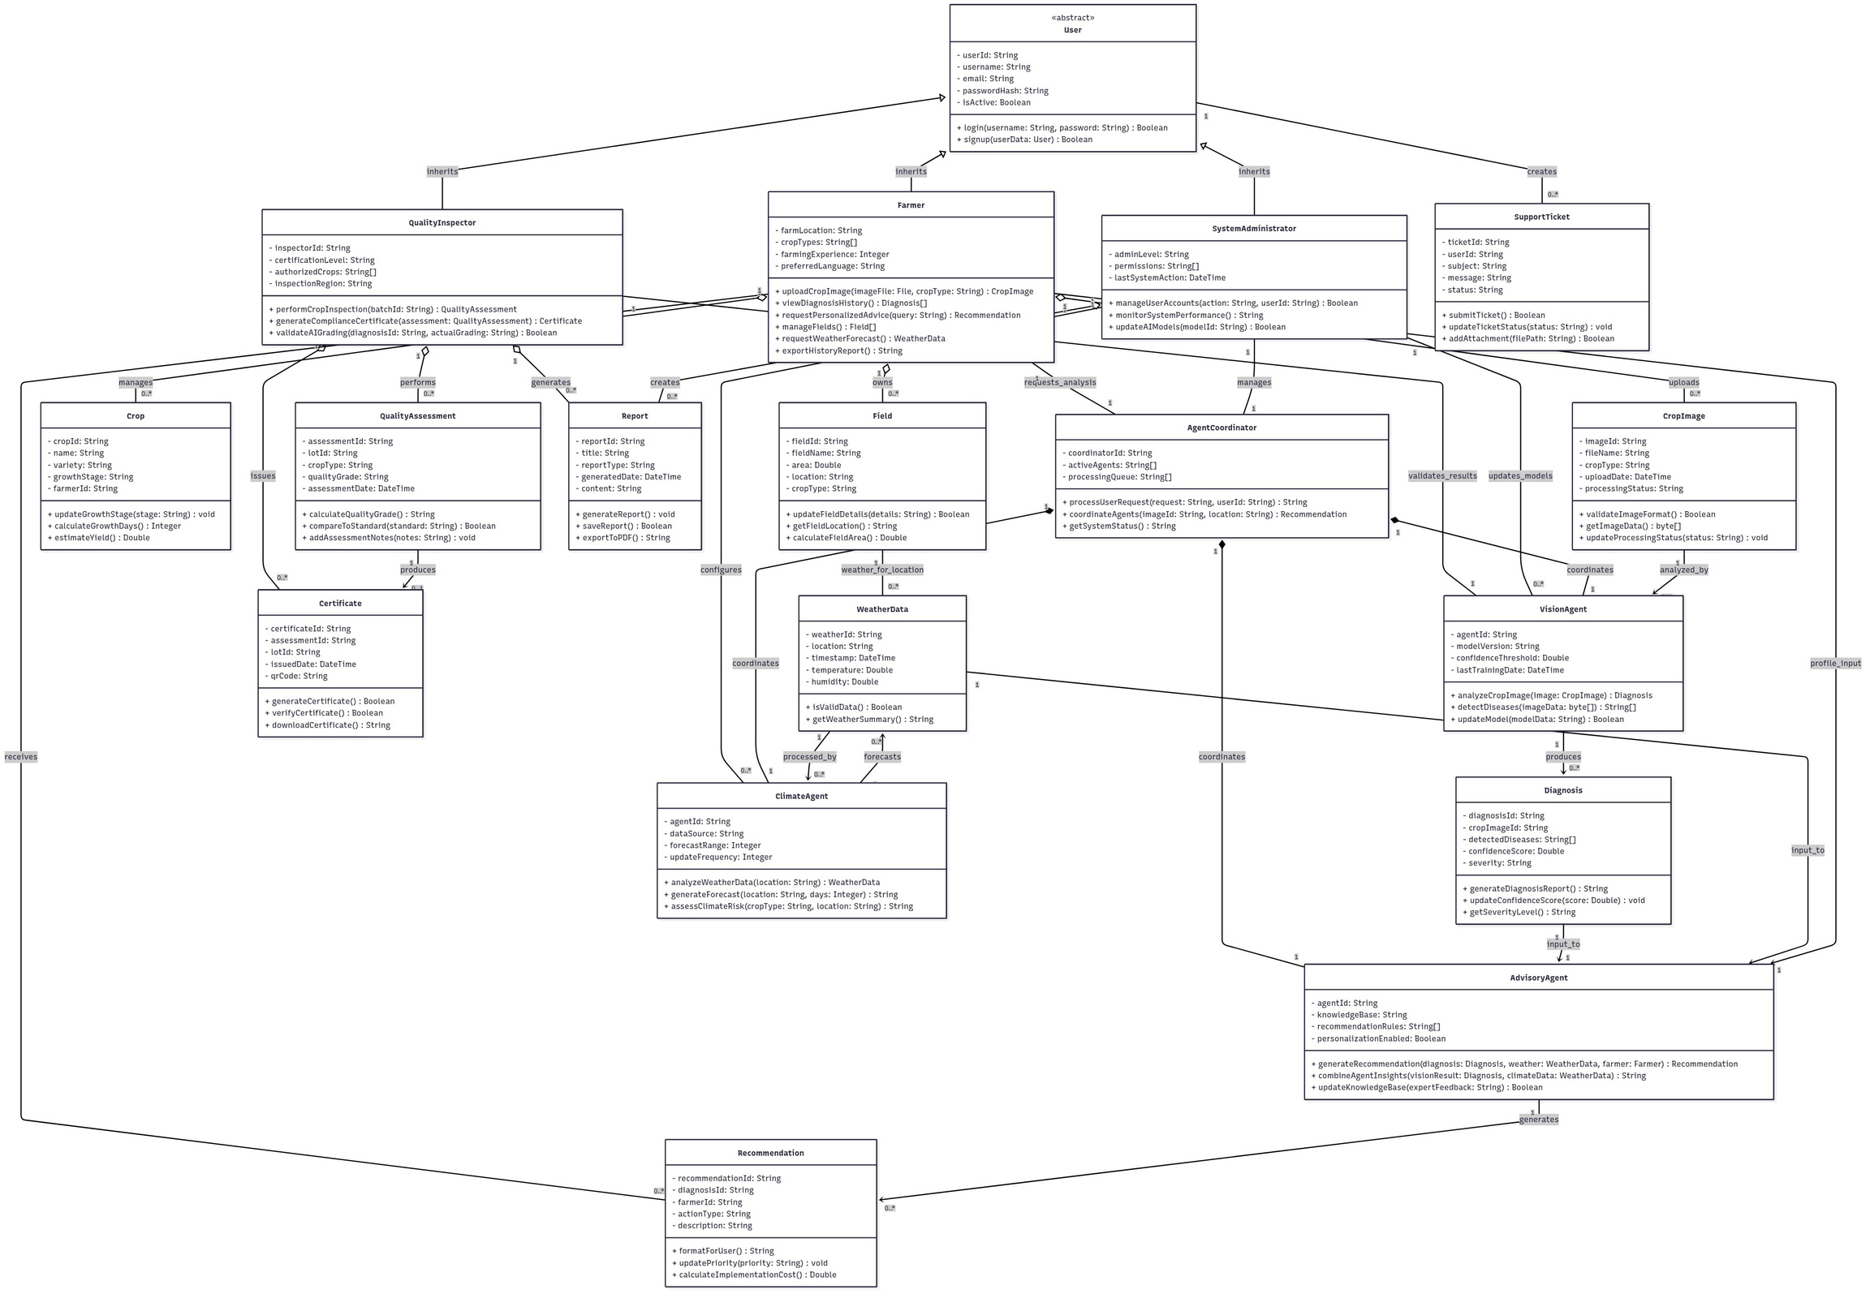
The class diagram

Slide 4
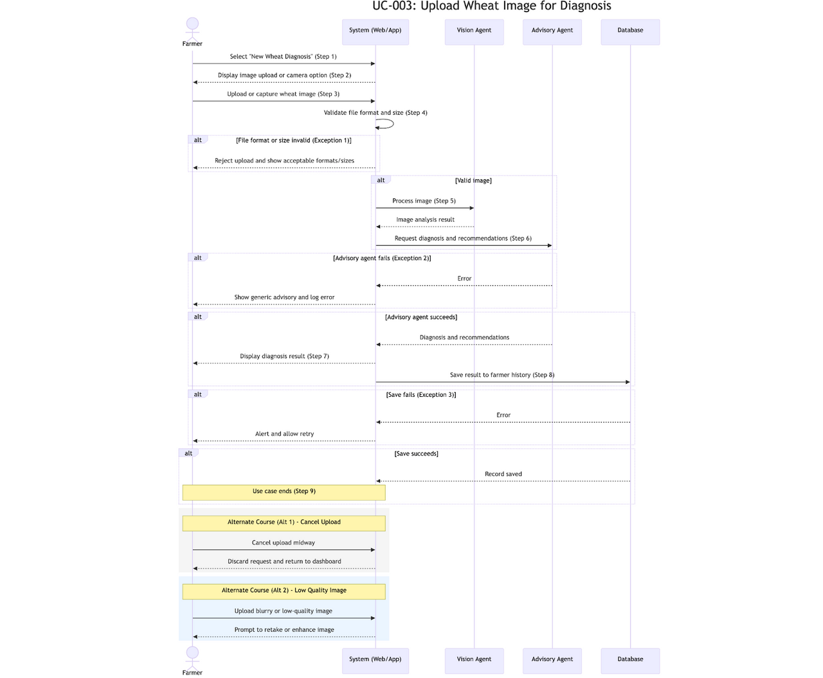
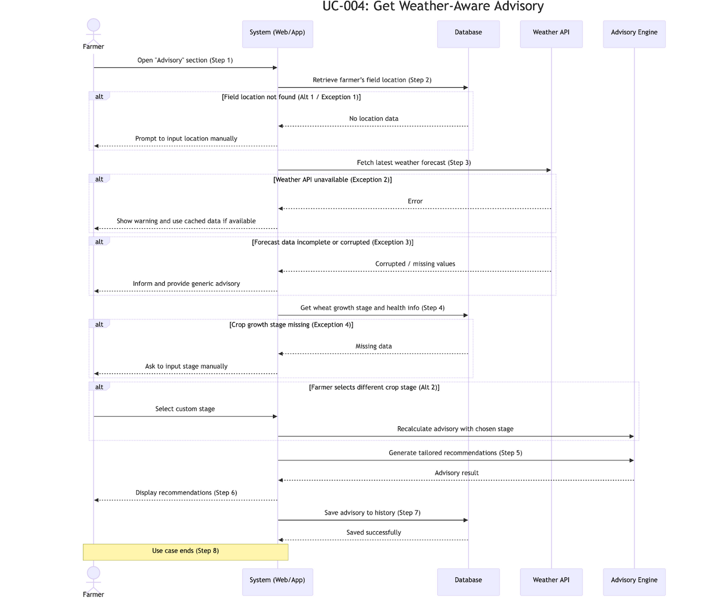
Sequence Diagrams

Slide 5
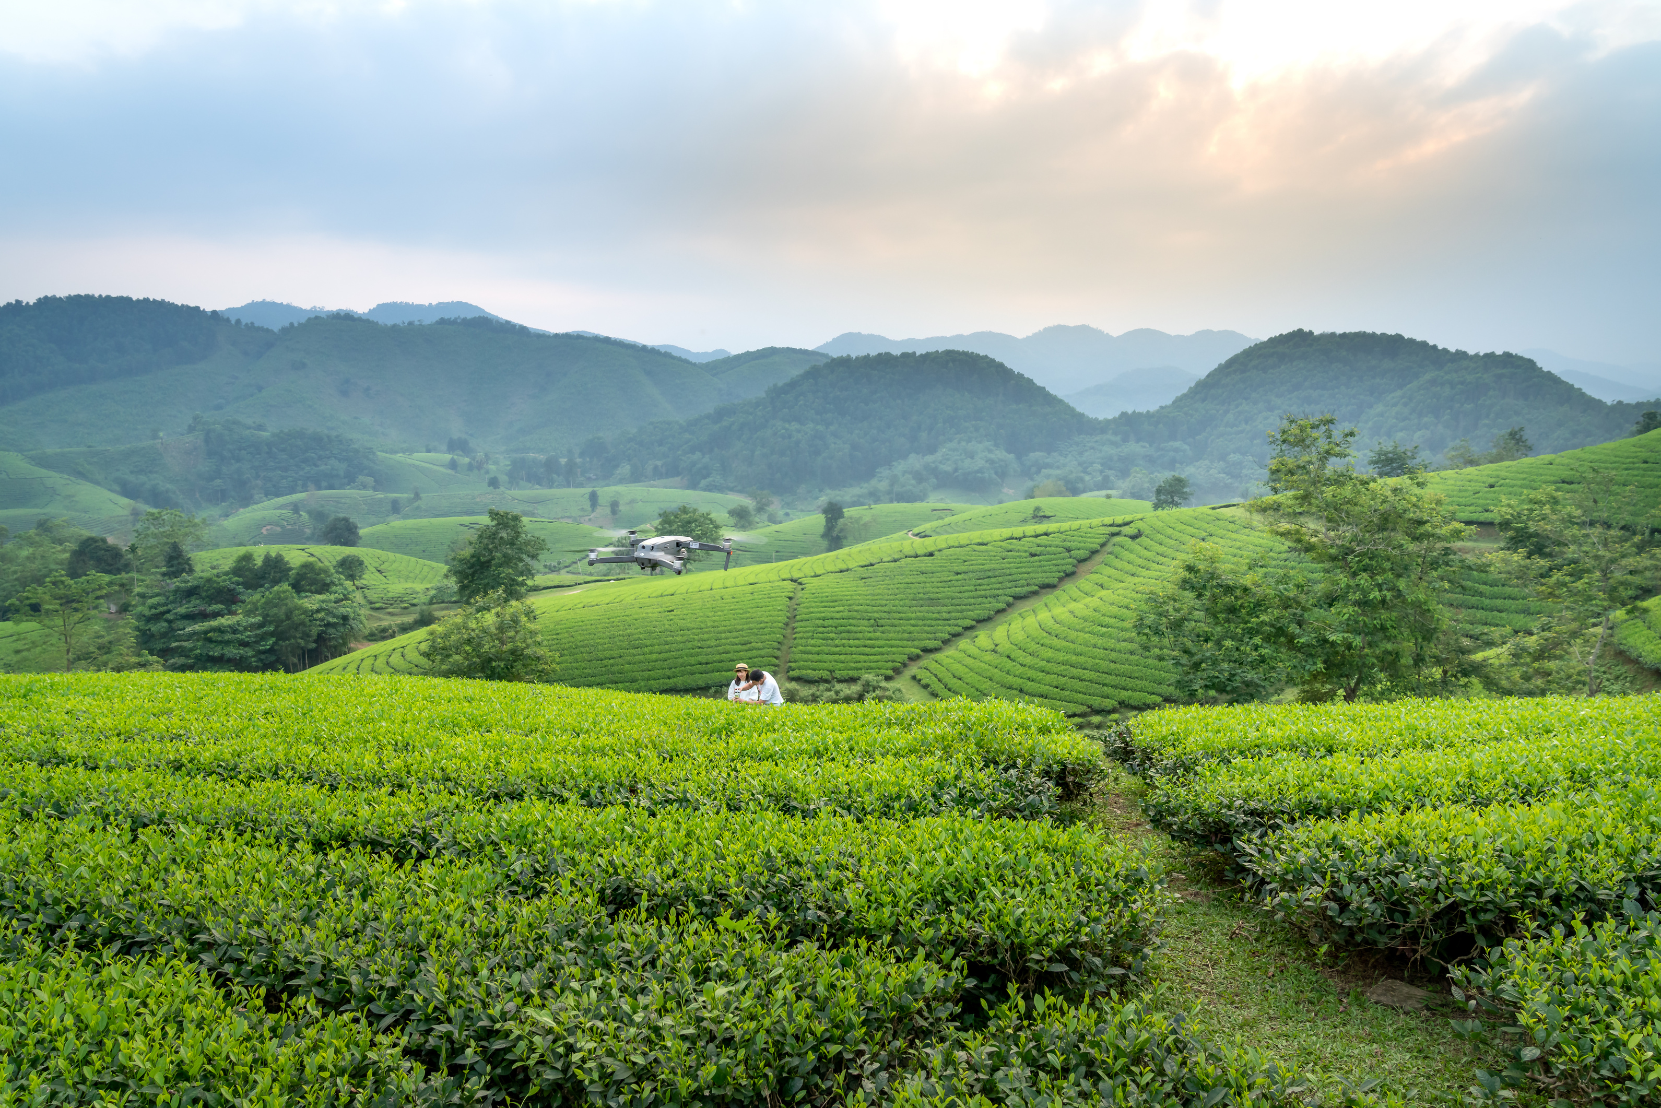
The dataset consists of over 6000 images at 1024x1024 pixel resolution
01
Training Dataset: 4000 images from Europe and Canada covering 7 measurement sessions
02
Data requirements?
Test Dataset: 2000 images from North America (except Canada), Asia, Oceania, and Africa covering 17 measurement sessions.
03
04
Bounding boxes must be complete; images without wheat heads should be clearly labeled as no_box
Pre-processing Requirements: Images should be normalized to 1024x1024 pixels. Data augmentation (rotation, flipping, brightness adjustment) may be applied to increase model robustness.
04

